Slide 1
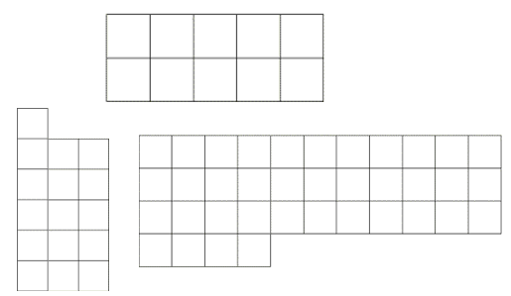
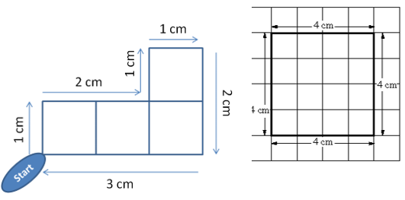
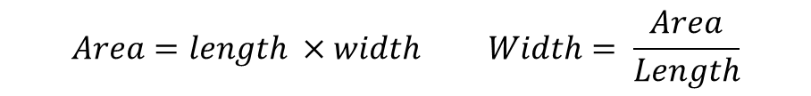
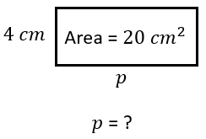
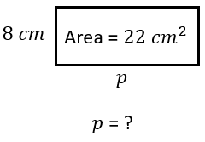
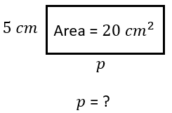



Subtopic N3.21 - Area: finding missing lengths given the area
LEARNING OUTCOME: To understand how to use a given area to find missing lengths of various shapes
Objectives:
Keywords:
- Area
- Length
- Width
- Height
- Perpendicular
To use a given area to find the missing length of a rectangle.
To use a given area to find the missing length of a parallelogram.
To use a given area to find the missing length of a triangle.
To use a given area to find the missing length of a compound shape.
Introduction – read and annotate:
So far in this booklet, you’ve explored multiplication and how it relates to calculating area. Now, you’re
going to use the division skills developed over the last few subtopics to find missing lengths when the
area is given. This process demonstrates how division can be used to work backwards from an area
measurement to determine a side length, reinforcing the connection between multiplication and
division in geometric contexts.
Definition
Characteristics
The measure of space in two dimensions contained within a boundary (perimeter).
The inside of a 2-D shape
Usually measured using squares of length one unit (where a unit can be cm, metre, inch etc.)
Examples
Area
Non - Examples
Finding a missing length given the area of a rectangle
Example 1 – I do…
Example 2 – We do…
Example 3 – You do…
Steps
1) Divide the area by the length given.

Slide 2
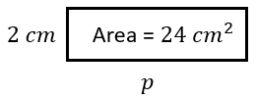
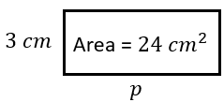
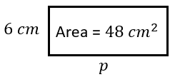









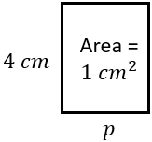
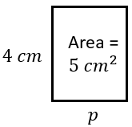
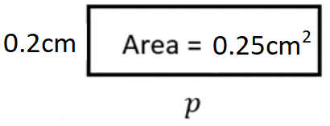



a) | b) | c)
d) | e) | f)
Independent Practice
Question 1. For each of the following, find the value of P.
g) | h) | i)
Question 2. Fill in the blanks with integer values.
Length | Width | Area
4 | 5 | 20
3 | 6 | 18
4 | 6 | 24
4 | 4 | 16
1 | 17 | 17

Slide 3
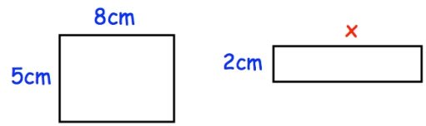
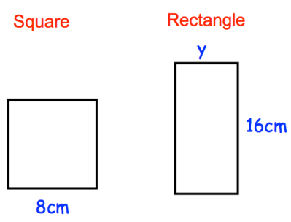
Question 3. A rectangle has an area of 30cm². Write down the length and width of three rectangles with an area of 30cm². | Question 4. These two rectangles have the same area. Find the length of the second rectangle.
Question 5. Shown below is a square and a rectangle. The square and rectangle have the same area. Find the value of y. | Question 6. A rectangle has an area of 36cm². The length of the rectangle is 4 times greater than the width of the rectangle. Work out the dimensions of the rectangle.
E.g. 1 x 30
2 x 15
5 x 6
3 x 10
4 x 7.5
20cm
4cm
3cm x 12cm
Question 7. A rectangle has an area of 80cm² and a perimeter of 48cm. Find the length and width of the rectangle. | Question 8. A rectangle has an area of 100cm² and a perimeter of 104cm. Find the length and width of the rectangle. | Question 9. A football pitch is 110m long and has a perimeter of 360m. Find the area of the football pitch.
4cm x 20cm
2cm x 50cm
7700m²

Slide 4
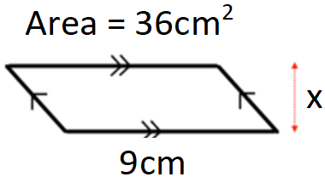
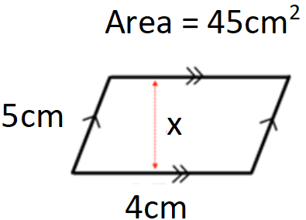
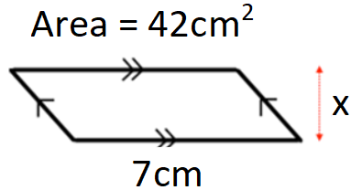
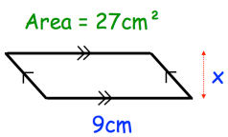
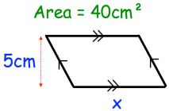
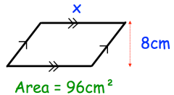
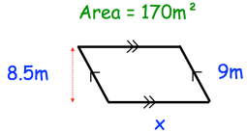
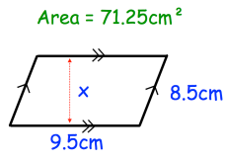
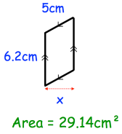
Finding a missing length given the area of a parallelogram
Example 7 – I do…
Example 8 – We do…
Example 9 – You do…
Steps
1) Divide the area by the length given.
4cm
11.25cm
6cm
Independent Practice
Question 10. For each of the following, calculate the length of the missing side, x.
a) | b) | c)
d) | e) | f)
3cm
8cm
12cm
20m
7.5cm
4.7cm
Question 11. Fill in the blanks with values.
Base | Perpendicular Height | Area
4 | 5 | 20
3 | 6 | 18
4 | 6 | 24
4 | 4.5 | 18
3.125 | 8 | 25

Slide 5
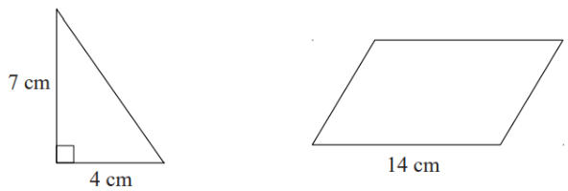
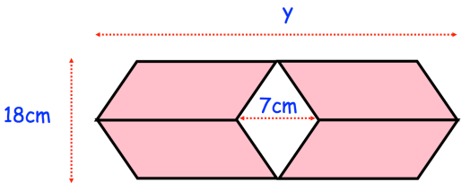
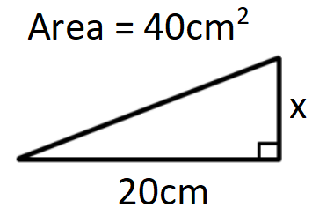
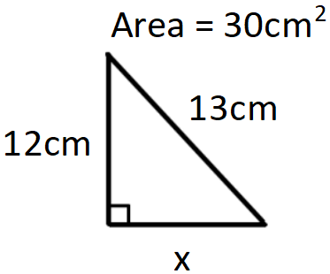
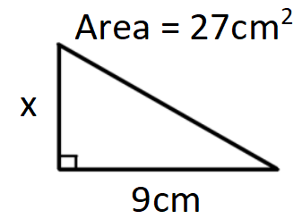
Question 12. The diagram shows a right-angled triangle and a parallelogram. The area of the parallelogram is four times the area of the triangle. The perpendicular height of the parallelogram is h. Find the value of h. | Question 13. A shape is made from 4 congruent parallelograms. The area of the shape is 792cm². Find y
4cm
40.5cm
Finding a missing length given the area of a triangle
Example 13 – I do…
Example 14 – We do…
Example 15 – You do…
Steps
1) Multiply the area by 2. 2) Divide by either the base or the perpendicular height, depending on what you are finding.
4cm
5cm
6cm

Slide 6
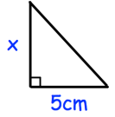
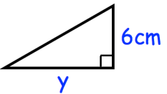
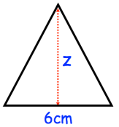
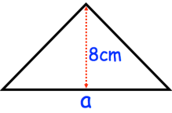
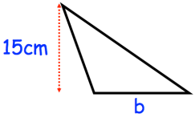
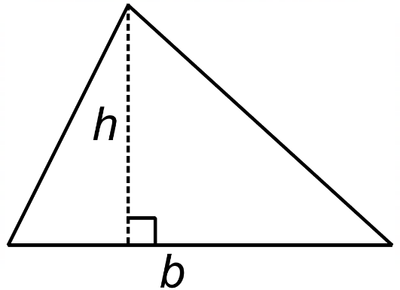
Independent Practice
Question 14.
a) The area of the triangle is 20cm², find x. | b) The area of the triangle is 30cm², find y. | c) The area of the triangle is 12cm², find z.
8cm
10cm
4cm
d) The area of the triangle is 56cm², find a. | e) The area of the triangle is 165cm², find b. | f) b = 5cm and the area of the triangle is 20 cm². Calculate the height of triangle h.
14cm
22cm
8cm
Question 15 – fill in the blanks with values.
Base | Perpendicular Height | Area
4 | 5 | 10
3 | 12 | 18
8 | 6 | 24
4 | 9 | 18
6.25 | 8 | 25

Slide 7
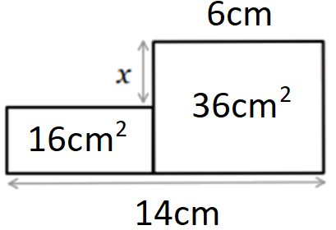
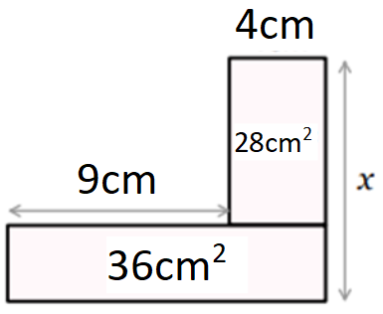
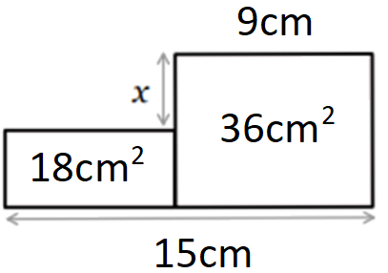
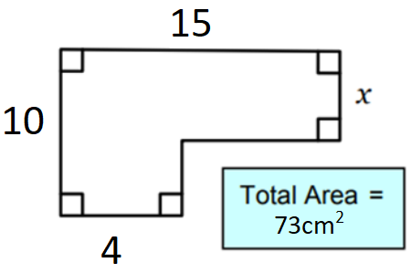
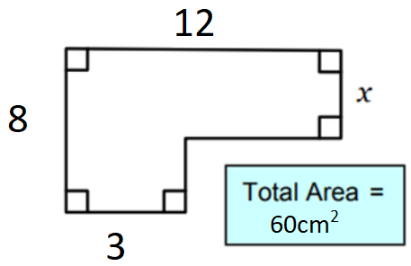
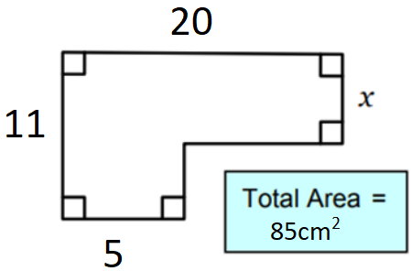
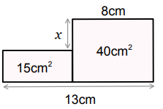
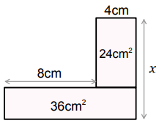
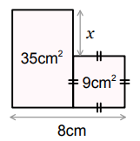
Finding a missing length given the area of a compound shape
Example 19 – I do…
Example 20 – We do…
Example 21 – You do…
x = 4
x = 10
x = 1
Example 22 – I do…
Example 23 – We do…
Example 24 – You do…
x = 3
x = 4
x = 2
Independent Practice
Question 16. For each of the following, calculate the length of the missing side, x.
a) | b) | c)
x = 2
x = 9
x = 4

Slide 8
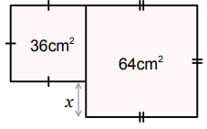
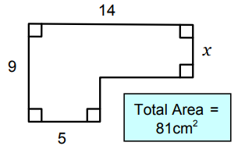
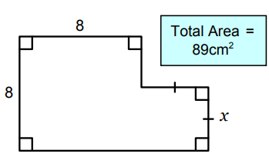
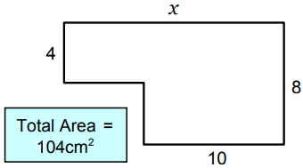
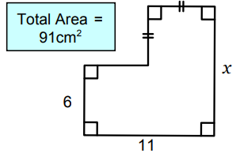
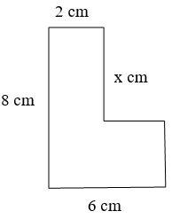
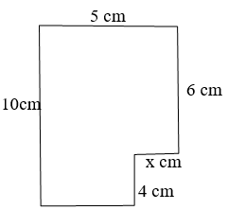


d) | e) | f)
x = 2
x = 4
x = 5
g) | h) | Area = 28cm²
x = 16
x = 11
x = 5
j) Area = 48cm² | k) Area = 46cm² | l) Area = 54cm²
x = 0.5
x = 5
x = 3

Slide 9






m) Area = 33cm² | n) Area = 55cm² | o) Area = 132cm²
x = 1
x = 6
x = 4
p) | q)
x = 6.25
x = 25

Slide 10

Skills Check
The area of the triangle is 60cm², find y.
The area of the triangle is 60cm², find y.
45cm
15cm B. 48cm
C. 135cm D. 43cm
55cm²
10cm B. 11cm
C. 275cm D. 5cm
5cm
10cm B. 360cm
C. 20cm D. 36cm
3cm B. 5cm
C. 21cm D. 12cm

